Slide 1
Python Data Structures

Slide 2
Learning Objectives
Strings
Lists
Tuples and Sets
Dictionary
Looping and Enumerating iterables
File Handling

Slide 3
Strings

Slide 4
Python Data Structures - Strings
Aside from the basic data types covered in Topic 1, other frequently used data types include:
Strings
Lists
Tuples
Dictionaries

Slide 5
Strings
Python has a built-in string class with many handy features.
String literals can be enclosed by either double or single quotes.
s1 = 'hi how are you'
s2 = "I am fine, thank you"

Slide 6
String Indices
Individual characters in a string can be accessed via their INDEX
Indexing starts with zero in Python strings
0 | 1 | 2 | 3 | 4 | 5 | 6 | 7 | 8 | 9 | 10 | 11 | 12 | 13
h | i |  | h | o | w |  | a | r | e |  | y | o | u
s = 'hi how are you'
print(s[0]) # this extracts the character with index 0 → h
print(s[1]) # this extracts the character with index 1 → i
print(s[3:6]) # this slices 3 characters from index 3 to index 5 → how
Notes:
s = 'hi how are you'
print(s[0])
print(s[1])
print(s[3:6]) # this slices 3 characters from index 3 to index 5 → how

Slide 7
Other string methods
You can check if a string is numeric or search in a string
You can change a string to upper or lower case
0 | 1 | 2 | 3 | 4 | 5 | 6 | 7 | 8 | 9 | 10 | 11 | 12 | 13
h | i |  | h | o | w |  | a | r | e |  | y | O | U
s = 'hi how are you‘
print(s.isnumeric()) # prints true if s is numeric → returns False
print(s.find('ar')) # return index of 'ar' in the string → returns 7 (-1 if not)
print(s.upper()) # this prints out the string in CAPS
print(s.lower()) # this prints out the string in lowercase
Notes:
s = 'hi how are you‘
print(s.isnumeric())
print(s.find('ar'))
print(s.upper())
print(s.lower())

Slide 8
Other string methods
You can retrieve the length of a string with the len function
You can add on to the string, or even apply a multiplier!
0 | 1 | 2 | 3 | 4 | 5 | 6 | 7 | 8 | 9 | 10 | 11 | 12 | 13
h | i |  | h | o | w |  | a | r | e |  | y | o | u
s = 'hi how are you‘
print(len(s)) # this prints the length of the string -> 14
print(s + ' today') # this concatenates the two strings
print(s*2) # prints s twice
Notes:
s = 'hi how are you‘
print(len(s))
print(s + ' today')
print(s*2)

Slide 9

Concatenate string and number
You cannot simply concatenate a string with a number
pi = 3.14
#text = 'The value of pi is ' + pi # This does NOT work
text = 'The value of pi is ' + str(pi) # This is ok
print(text)
# Or you could use the String formatter from topic 1!
text = f'The value of pi is {pi}'
print(text)
Notes:
pi = 3.14
text = 'The value of pi is ' + str(pi)
print(text)
text = f'The value of pi is {pi}'
print(text)

Slide 10
Splitting a string
0 | 1 | 2 | 3 | 4 | 5 | 6 | 7 | 8 | 9 | 10 | 11 | 12 | 13
h | i |  | h | o | w |  | a | r | e |  | y | o | u
s = 'hi how are you'
words = s.split(sep=' ') # splits s into a list, using space as separator
print(words[2]) → returns "are"
words[0]
hi
words[1]
how
words[2]
are
words[3]
you
Notes:
s = 'hi how are you'
words = s.split(sep=' ')
print(words[2])

Slide 11
Splitting a string
0 | 1 | 2 | 3 | 4 | 5 | 6 | 7 | 8 | 9 | 10 | 11 | 12 | 13
h | i | : |  | h | e | l | l | o | : |  | h | e | y
s = 'hi: hello: hey‘
words = s.split(sep=‘:') # splits s into a list, using ‘:’ as separator
print(words[2]) → prints " hey" with space in front
print(words[2].strip()) → strip() method trims all whitespace (\t\n) – returns "hey"
words[0]
hi
words[1]
hello
words[2]
hey
Notes:
s = 'hi: hello: hey‘
words = s.split(sep=‘:')
print(words[2])
print(words[2].strip())

Slide 12
Practice - Strings
P03
Notes:
Prac2-Q1 to Q3

Slide 13
Lists

Slide 14
Python Lists
Python uses Lists to represent an array
used to store collections of similar (or dissimilar) items
Create a list by putting comma-separated values between square brackets
not_a_list = 'red'
list1 = ['red', 'green', 'blue']
list2 = [‘DICS1', ‘DICS2', 2017, 2018]
list3 = [1, 2, 3, 4, 5 ]
list4 = ["a", "b", "c", "d"]
Notes:
Most programming languages will have an array construct but Python uses Lists to represent an array
The Python List class is used to store collections of (usually) similar or (sometimes) dissimilar items
I know this sounds confusing but we can contrast this with tuples later
Creating a list is as simple as putting different comma-separated values between square brackets

Slide 15
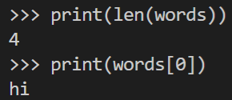
Accessing Elements in Lists
Like string indices, list indices start at 0, and can be sliced, concatenated etc.
Get the length of a Python list by using the len() function
words = ['hi', 'how', 'are', 'you’]
print(len(words)) # returns 4
print(words[0]) # returns ‘hi’
words[0]
hi
words[1]
how
words[2]
are
words[3]
you
Notes:
words = ['hi', 'how', 'are', 'you’]
print(len(words))
print(words[0])

Slide 16
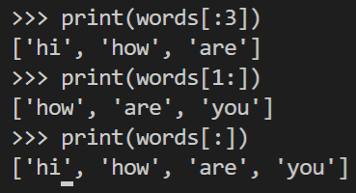
List Slicing
Syntax: listName [start:end] e.g. words[1:3] -> ['how','are']
Returns list items from index=start to index=end-1
Defaults for start is 0, end is list’s len()
words[0]
hi
words[1]
how
words[2]
are
words[3]
you
print(words[:3]) # start defaults to 0
print(words[1:]) # end defaults to 4
print(words[:]) # prints the whole list
Notes:
print(words[:3])
print(words[1:])
print(words[:])

Slide 17


List Slicing – negative indices
When you give a negative index number, Python finds the elements counting from the right
words[0]
hi
words[1]
how
words[2]
are
words[3]
you
print(words[-1]) # same as len()-1 -> words[3]
print(words[:-2]) # from 0 (default) to len() -2 ->words[0:2]
Notes:
print(words[-1])
print(words[:-2])

Slide 18


List Slicing – steps
Syntax: listName [start:end:step]
words[0]
hi
words[1]
how
words[2]
are
words[3]
you
print(words[::2]) # pick alternate words at indices 0,2,4…
print(words[::-1]) # reverse order
Notes:
print(words[::2])
print(words[::-1])

Slide 19
Accessing Elements in Lists
To access elements in lists, use the square brackets for slicing along with the index or indices to obtain elements at that index
classlist = ['Andy', 'Bryan', 'Calvin', 'Donna', 'Evelyn', 'Francine']
print(classlist[0]) ## Andy
print(classlist[2:4]) ## [‘Calvin’, ‘Donna’]
print(classlist[-1:]) ## [‘Francine’]
print(classlist[-2:]) ## [‘Evelyn’, ‘Francine’]
Notes:
classlist = ['Andy', 'Bryan', 'Calvin', 'Donna', 'Evelyn', 'Francine']
print(classlist[0])
print(classlist[2:4])
print(classlist[-1:])
print(classlist[-2:])

Slide 20
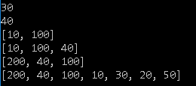
Accessing Elements in Lists
Another example to show how you can "slice" lists
list1 = [50,20,30,10,100,40,200]
print(list1[2]) # 3rd element from the front -> 30
print(list1[-2]) # 2nd element from the back -> 40
print(list1[3:5]) # 4th to 5th element -> 10 100
print(list1[-4:-1]) #10 100 40
print(list1[-1:-4:-1]) #200 40 100
print(list1[::-1]) #200 40 100 ...
Notes:
list1 = [50,20,30,10,100,40,200]
print(list1[2])
print(list1[-2])
print(list1[3:5])
print(list1[-4:-1])
print(list1[-1:-4:-1])
print(list1[::-1])

Slide 21
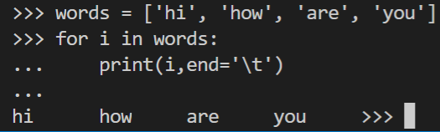
Iterate through a List
You can use the for loop to iterate through a Python list
words[0]
hi
words[1]
how
words[2]
are
words[3]
you
Notes:
words = ['hi', 'how', 'are', 'you']
for i in words:
print(i,end='\t')

Slide 22
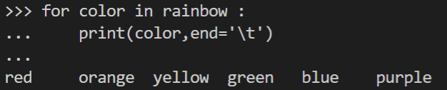
Iterate through a List
You can use the for loop to iterate through a Python list
rainbow = ['red', 'orange', 'yellow', 'green', 'blue', 'purple']
for color in rainbow :
print(color)
Notes:
rainbow = ['red', 'orange', 'yellow', 'green', 'blue', 'purple']
for color in rainbow :
print(color)

Slide 23

More examples
numbers = [1,2,3,4,5,6,7,8,9,10]
for n in numbers:
print(n) # 1,2,3,4,5,6,7,8,9,10
for i in range(5):
print(numbers[i]) # 1,2,3,4,5
for index in range(2,5):
print('Current number:', numbers[index])
Notes:
numbers = [1,2,3,4,5,6,7,8,9,10]
for n in numbers:
print(n)
for i in range(5):
print(numbers[i])
for index in range(2,5):
print('Current number:', numbers[index])

Slide 24
Updating Lists
To add elements in a list, use append() or insert() methods
os = ['Windows10', 'Ubuntu', 'Redhat']
os.append('Kali') # add new item at the back
os.insert(1, 'Debby') # insert new item at the index 1
os[1] = 'Debian' # update value at index 1
Notes:
os = ['Windows10', 'Ubuntu', 'Redhat']
os.append('Kali')
print(os)
os.insert(1, 'Debby')
print(os)
os[1] = 'Debian'
print(os)

Slide 25
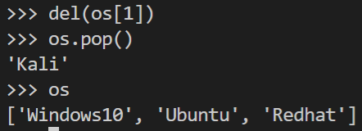
Updating Lists
To add elements in a list, use append() or insert() methods
To remove elements in a list, use del() or pop() methods
os = ['Windows10', 'Ubuntu', 'Redhat']
os.append('Kali')
os.insert(1, 'Debby')
os[1] = 'Debian'
del(os[1]) # removes ‘Debian’ at index 1
os.pop() # returns the last object ‘Kali’
Notes:
os = ['Windows10', 'Ubuntu', 'Redhat']
os.append('Kali')
print(os)
os.insert(1, 'Debby')
print(os)
os[1] = 'Debian'
print(os)
del(os[1])
print(os)
os.pop()
print(os)

Slide 26
Updating Lists
You can update a list by giving the slice on the left-hand side of the assignment operator
os = ['Windows10', 'Ubuntu', 'Redhat']
os[0:0] = ['Debian', 'Kali', 'WindowsXP', 'WindowsVista']
print(os)
os[2:5] = ['WindowsOS']
print(os)
Notes:
os = ['Windows10', 'Ubuntu', 'Redhat']
os[0:0] = ['Debian', 'Kali', 'WindowsXP', 'WindowsVista']
print(os)
os[2:5] = ['WindowsOS']
print(os)

Slide 27
Updating Lists
You can update a list by giving the slice on the left-hand side of the assignment operator
os = ['Windows10', 'Ubuntu', 'Redhat']
os[0] = ['Debian', 'Kali', 'WindowsXP', 'WindowsVista']
print(os)
os[2:5] = ['WindowsOS']
print(os)
Notes:
os = ['Windows10', 'Ubuntu', 'Redhat']
os[0] = ['Debian', 'Kali', 'WindowsXP', 'WindowsVista']
print(os)
os[2:5] = ['WindowsOS']
print(os)

Slide 28

+ and * operations on Lists
Lists respond to the + and * operators much like strings, equating to concatenation (+) and repetition (*) as well
tcp = [21,23,443]
udp = [53,135]
open_ports = tcp+udp
print(open_ports)
Notes:
https://www.dummies.com/programming/networking/commonly-hacked-ports/
tcp = [21,23,443]
udp = [53,135]
open_ports = tcp+udp
print(open_ports)

Slide 29
+ and * operations on Lists
Lists respond to the + and * operators much like strings, equating to concatenation (+) and repetition (*) as well
os = ['Windows10', 'Ubuntu', 'Redhat']
print(os*2)
Notes:
https://www.dummies.com/programming/networking/commonly-hacked-ports/
os = ['Windows10', 'Ubuntu', 'Redhat']
print(os*2)

Slide 30
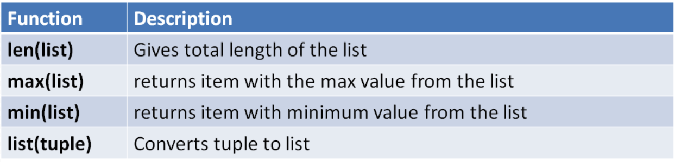
Built-in List Functions
Commonly used Python list functions
Notes:
https://www.quackit.com/python/reference/python_3_list_methods.cfm

Slide 31
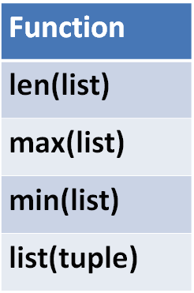

Built-in List Functions
mylist = [50,20,30,10,100,40,200]
mytuple = (50,20,30,10,100,40,200)
print(len(mylist)) # print(len(mytuple))
print(max(mylist)) # print(len(mytuple))
print(min(mylist)) # print(len(mytuple))
print(list(mytuple))
Notes:
https://www.quackit.com/python/reference/python_3_list_methods.cfm
mylist = [50,20,30,10,100,40,200]
mytuple = (50,20,30,10,100,40,200)
print(len(mylist))
print(max(mylist))
print(min(mylist))
print(list(mytuple))

Slide 32

Built-in List Functions
The max and min functions also works for text!
os = ['Windows10', 'Ubuntu', 'Redhat', 'windows10']
print(max(os)) # based on ASCII sequence
print(min(os))
Notes:
https://www.quackit.com/python/reference/python_3_list_methods.cfm
os = ['Windows10', 'Ubuntu', 'Redhat']
print(max(os))
print(min(os))

Slide 33
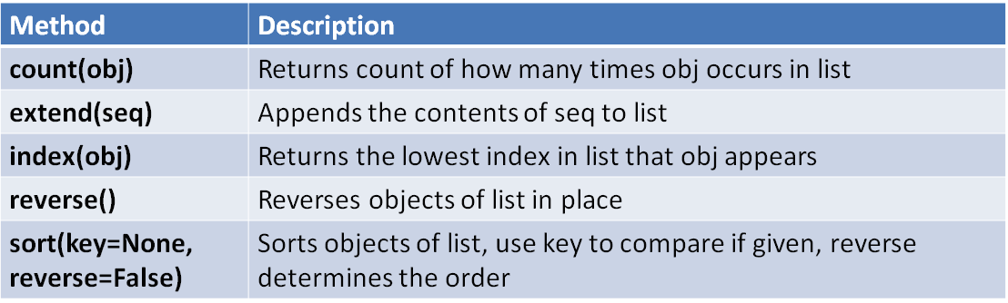
Built-in List Methods
Commonly used Python list methods
Notes:
https://docs.python.org/3/tutorial/datastructures.html

Slide 34
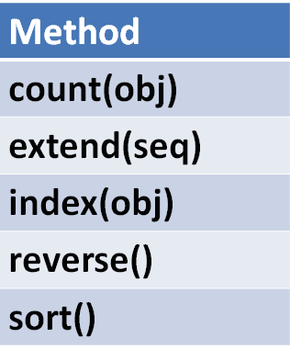

Built-in List Methods
os = ['Windows10', 'Ubuntu', 'Redhat']
os.extend(['Ubuntu', 'Kali','Ubuntu'])
print(os)
print(os.count('Ubuntu'))
print(os.index('Ubuntu'))
os.reverse()
print(os)
Notes:
https://docs.python.org/3/tutorial/datastructures.html
os = ['Windows10', 'Ubuntu', 'Redhat']
os.extend(['Ubuntu', 'Kali','Ubuntu'])
print(os)
print(os.count('Ubuntu'))
print(os.index('Ubuntu'))
os.reverse()
print(os)

Slide 35
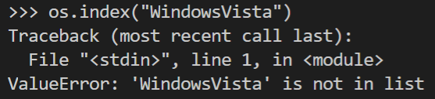
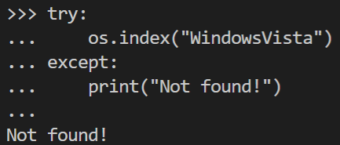
What if index(obj) is not found?
Notes:
print(os.count('WindowsVista')) # returns 0
print(os.index('WindowsVista')) # run-time error

Slide 36
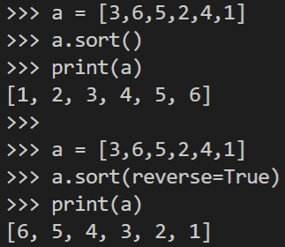


Built-in List Sort method
a = ["bee", "wasp", "butterfly"]
a.sort(key=None)
print(a)
a = ["bee", "wasp", "butterfly"]
a.sort(key=None, reverse=True)
print(a)
a = ["wasp", "bee", "butterfly"]
a.sort(key=len)
print(a)
a = ["wasp", "bee", "butterfly"]
a.sort(key=len, reverse=True)
print(a)
Sorting based on ASCII sequence
Sorting based on length of string
Notes:
Source: https://www.quackit.com/python/reference/python_3_list_methods.cfm
a = ["bee", "wasp", "butterfly"]
a.sort(key=None) # based on ASCII sequence
print(a)
a = ["bee", "wasp", "butterfly"]
a.sort(key=None, reverse=True)
print(a)
---
a = ["wasp", "bee", "butterfly"]
a.sort(key=len)
print(a)
a = ["wasp", "bee", "butterfly"]
a.sort(key=len, reverse=True)
print(a)

Slide 37
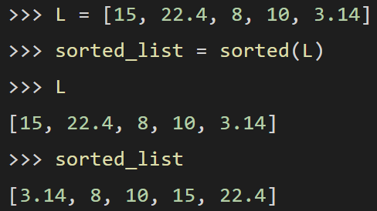
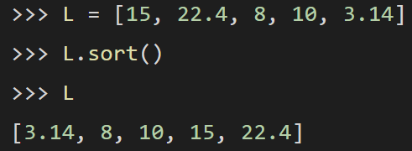
List Sorted function
List also has a sorted function
New list is created
Original list is intact
Sorted function
Sort method

Slide 38
List Comprehensions (optional)
List comprehensions are a common way to create lists
# normal list creation
numbers = [1, 2, 3, 4]
squares = []
for n in numbers:
squares.append(n**2)
print(squares) # [1, 4, 9, 16]
# using list comprehension
numbers = [1, 2, 3, 4]
squares = [n**2 for n in numbers]
print(squares) # [1, 4, 9, 16]
Notes:
While not covered in this module, list comprehensions are a common way to create lists. You will find many sample codes online using list comprehensions so we briefly introduce it here.
If interested, you can learn more here:
https://www.linkedin.com/learning/python-essential-training-2018/list-comprehension?trk=lynda_redirect_learning
***
https://realpython.com/list-comprehension-python/

Slide 39
List Comprehension
Python is famous for allowing you to write code that’s elegant, easy to write, and almost as easy to read as plain English.
One of the language’s most distinctive features is the list comprehension, which you can use to create powerful functionality within a single line of code.
However, many developers struggle to fully leverage the more advanced features of a list comprehension in Python. Some programmers even use them too much, which can lead to code that’s less efficient and harder to read.

Slide 40
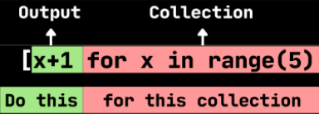
List Comprehension - Create Lists in Python
List comprehension is a common way to create lists
# for loop
squares = []
for i in range(10):
squares.append(i * i)
print(squares)
# lambda/map
ls = [0,1,2,3,4,5,6,7,8,9]
ls_square = list(map(lambda x: x*x, ls))
print(ls_square)
# comprehension
squares = [i * i for i in range(10)]
print(squares)
Notes:
# for loop
squares = []
for i in range(10):
squares.append(i * i)
print(squares) # [0, 1, 4, 9, 16, 25, 36, 49, 64, 81]
# lambda/map
ls = [0,1,2,3,4,5,6,7,8,9]
ls_square = list(map(lambda x: x*x, ls))
print(ls_square)
# comprehension
squares = [i * i for i in range(10)]
print(squares)
https://realpython.com/list-comprehension-python/
https://www.freecodecamp.org/news/list-comprehension-in-python/

Slide 41
List Comprehension - with if condition
lst = [1,2,3,4,5,6,7,8,9,10]
# with if condition
c = [x for x in lst if x > 4]
print(c) # output [5, 6, 7, 8, 9, 10]
# with multiple if
d = [x for x in lst if x > 4 if x%2 == 0]
print(d) # output [6, 8, 10]
Notes:
https://www.freecodecamp.org/news/list-comprehension-in-python/

Slide 42
List Comprehensions (optional)
List comprehensions are a common way to create lists
Can include conditional statements
# using list comprehension
numbers = [1, 2, 3, 4]
squares = [n**2 for n in numbers if n%2==0] #only even numbers
print(squares) # [4, 16]
Notes:
While not covered in this module, list comprehensions are a common way to create lists. You will find many sample codes online using list comprehensions so we briefly introduce it here.
If interested, you can learn more here: https://www.lynda.com/Python-tutorials/List-comprehension/614299/687523-4.html?org=sp.edu.sg
squares = [n**2 for n in numbers if n%2==0 if n > 2]

Slide 43
Python Tuples and Sets

Slide 44
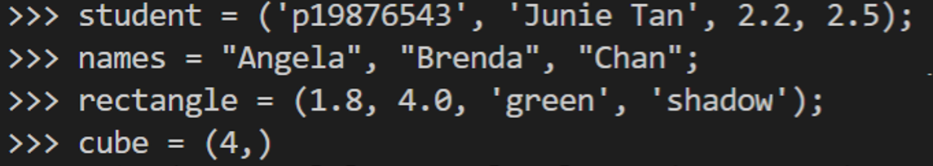
Python Tuples
A tuple is like a list that can store different types of data
Tuples use round brackets instead of square brackets
; is Not required
Notes:
student = ('p19876543', 'Junie Tan', 2.2, 2.5)
names = "Angela", "Brenda", "Chan"; #default sequence will create a tuple too
rectangle = (1.8, 4.0, 'green', 'shadow')
cube = (4,) # it is a must to put a comma, if only single value is used
print(student[0], names[1:3], len(rectangle), cube[-1])
cube = (4); number 4 is assigned to cube

Slide 45
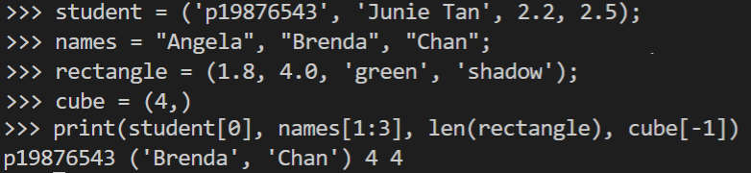
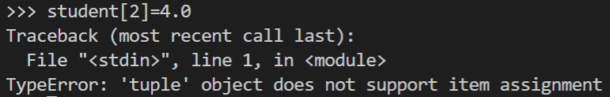
Python Tuples are Immutable
Main difference: Tuple is immutable (cannot be changed)
Cannot change a value

Slide 46
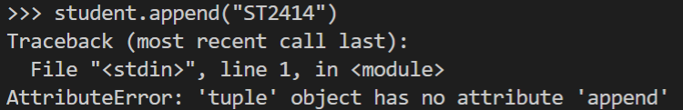
Python Tuples are Immutable
Main difference: Tuple is immutable (cannot be changed)
Cannot change a value
Cannot append

Slide 47
Python Tuples vs List
List was to serve as array (same type of data) e.g.
workdays = ["Mon","Tue","Wed","Thu","Fri"]
ratings =[3.5,4.0,3.0,4.5]
Able to add or change the lists, like add "Sat" or a new user rating of 5.0
Your program could iterate through ratings and compute a new average or print workdays as the values are standardised

Slide 48
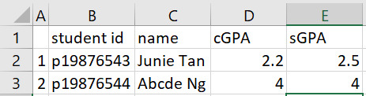
Python Tuples vs List
Tuple was created to store a row of data e.g.
student = ('p19876543', 'Junie Tan', 2.2, 2.5);
movie =("Dark Phoenix", "GV Bishan","Cinema1",1300)
The order and structure of the tuple has meaning like studentid, name, cGPA, sGPA or Title, Cinema, and timing.
Understanding of the structure is needed for your processing.
Adding or changing values to tuples would affect the meaning or structure of the data making it harder to process.
Notes:
Tuple definition: (in a relational database) an ordered set of data constituting a record.

Slide 49
Python Tuples vs List
However, many people now use the structures interchangeably since lists could also accept different data types.
Meaning behind the differences became obscured.
Do note the main difference though.
Main difference: Tuple is immutable (cannot be changed)

Slide 50
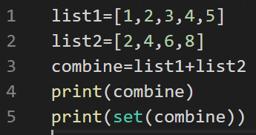
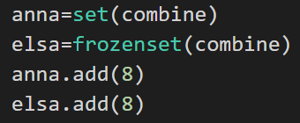

Python Sets
You will sometimes encounter code that use Python Sets
Set is like a list with no duplicates
Frozen sets are immutable sets
Success
Fail
Notes:
https://www.geeksforgeeks.org/sets-in-python/
A Set is an unordered collection data type that is iterable, mutable, and has no duplicate elements. Python’s set class represents the mathematical notion of a set. The major advantage of using a set, as opposed to a list, is that it has a highly optimized method for checking whether a specific element is contained in the set
list1=[1,2,3,4,5]
list2=[2,4,6,8]
combine=list1+list2
print(combine)
print(set(combine))

Slide 51
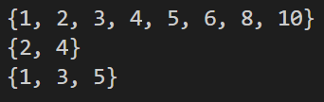
Python Sets
Methods (functions) include
add(x): adds x not already present
union(x): (|) all items in two sets
intersection(x): (&) common items in both sets
set1.difference(x): (-) returns a set of all elements in set1 but not set x
set1={1, 2, 3, 4, 5}
set2={2, 4, 6, 8}
set2.add( 10) #adds 10 to set2
print(set1.union(set2))
print(set1.intersection(set2))
print(set1.difference( set2))
Notes:
setl={1, 2, 3, 4, 5}
set2={2, 4, 6, 8}
set2.add( 10) #adds 10 to set2
print(setl.union(set2))
print(setl.intersection(set2))
print(setl.difference( set2))

Slide 52
Practice – List/Tuple
P03
Notes:
Prac2-Q1 to Q3

Slide 53
Python Dictionaries

Slide 54
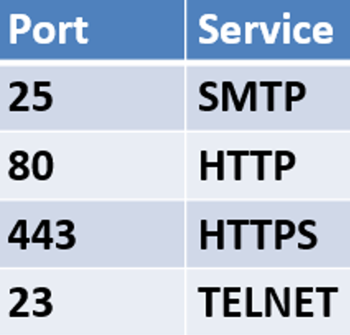
Python Dictionary
A data type that stores data using key-value pairs.
A telephone directory is a good example, where the key is the person or business name, and the value is the phone number.
Each value stored in a dictionary can be accessed using a unique key, which is any type of object instead of using its index to access it.
For example, a database of open ports could be stored using a dictionary.
Notes:
Note key must be unique, otherwise the older value would be replaced with the new value

Slide 55
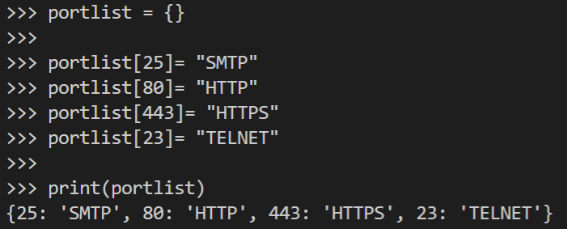
Creating Python Dictionary
You can create a dictionary by adding one key-value pair of at a time
Notes:
portlist = {}
portlist[25]= "SMTP"
portlist[80]= "HTTP"
portlist[443]= "HTTPS"
portlist[23]= "TELNET"
print(portlist)

Slide 56


Creating Python Dictionary
You can also create the dictionary out of multiple key-value pairs
You can list the keys in a dictionary using keys() method
Notes:
portlist = {25:"SMTP",80:"HTTP",443:"HTTPS",23:"TELNET"}
print(portlist)
portlist.keys()

Slide 57
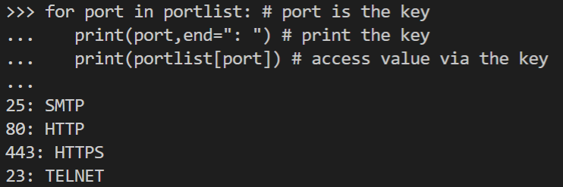
Accessing Dictionary values
You can use the key to access its value
Notes:
for port in portlist: # port is the key
print(port,end=": ") # print the key
print(portlist[port]) # access value via the key

Slide 58
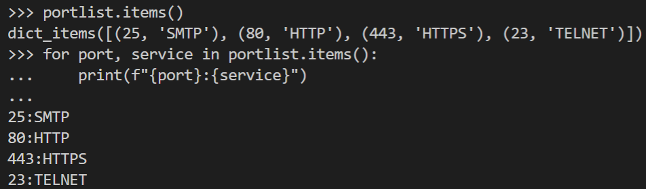
Accessing Dictionary values
You can also use items() to access the name-value pairs
Notes:
portlist.items()
for port, service in portlist.items():
print(f"{port}:{service}")

Slide 59

Manipulating key-value pair
The portlist dictionary can identify service on a given port
portlist = {25:"SMTP",80:"HTTP",443:"HTTPS",23:"TELNET"}
# what is the service using port 23?
print(portlist[23]) # returns TELNET
Notes:
portlist = {25:"SMTP",80:"HTTP",443:"HTTPS",23:"TELNET"}
# what is the service using port 23?
print(portlist[23]) # returns TELNET
portlist = {25:"SMTP",80:"HTTP",443:"HTTPS",23:"TELNET"}
pkey = 23
portlist.get(pkey)

Slide 60
Manipulating key-value pair
What if you need to find the service (value) instead of accessing via the port (key)? For example, which port is the SMTP service using?
Change to

Slide 61
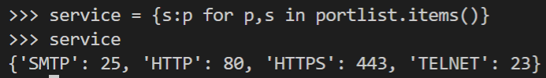
Manipulating key-value pair
Change to
Notes:
portlist = {25:"SMTP",80:"HTTP",443:"HTTPS",23:"TELNET"}
service = {s:p for p,s in portlist.items()}
service

Slide 62
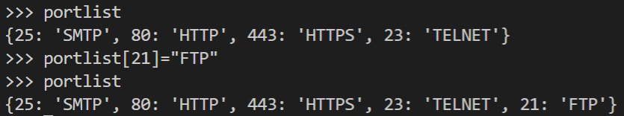

Adding to Dictionary
Adding key value to the dictionary is similar to list
What if the new key value is not unique?
Notes:
portlist = {25:"SMTP",80:"HTTP",443:"HTTPS",23:"TELNET"}
portlist[21]="FTP"
portlist

Slide 63
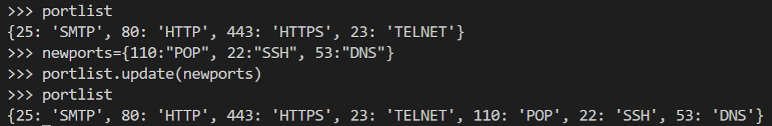
Adding to Dictionary
Add multiple values using update()
Notes:
portlist = {25:"SMTP",80:"HTTP",443:"HTTPS",23:"TELNET"}
portlist[21]="FTP"
newports={110:"POP", 22:"SSH", 53:"DNS"}
portlist.update(newports)

Slide 64
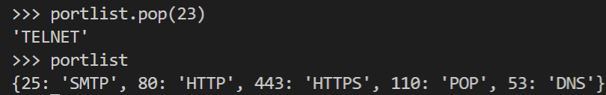
Removing values from Dictionary
del() function - Removes a key value pair using the key
pop() method – Returns and removes using the key
Notes:
portlist = {25:"SMTP",80:"HTTP",443:"HTTPS",23:"TELNET",110:"POP", 22:"SSH", 53:"DNS"}
del(portlist[22])
portlist.pop(23)
portlist
23)

Slide 65

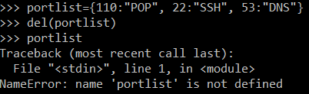
Clearing a Dictionary
clear() method empties the Dictionary
del() function can removes the dictionary
Notes:
portlist={110:"POP", 22:"SSH", 53:"DNS"}
portlist.clear()
portlist
portlist={110:"POP", 22:"SSH", 53:"DNS"}
del(portlist)
portlist

Slide 66
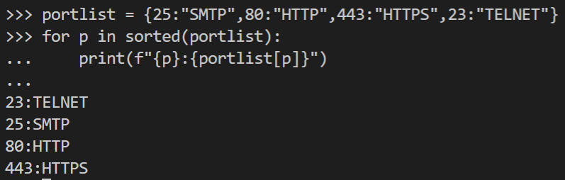
Other Dictionary functions
You can use the sorted function to sort your dictionary
Port | Service
25 | SMTP
80 | HTTP
443 | HTTPS
23 | TELNET
The original list is unchanged.
Notes:
portlist = {25:"SMTP",80:"HTTP",443:"HTTPS",23:"TELNET"}
for p in sorted(portlist):
print(f'{p}: {portlist[p]}')
print(portlist)

Slide 67
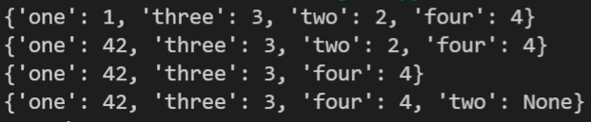
Python version – Dictionary
From version 3.6 onwards Dictionaries preserve insertion order. Note that updating a key does not affect the order. Keys added after deletion are inserted at the end.
lst = {"one": 1, "three": 3, "two": 2, "four": 4}
print(lst)
lst["one"] = 42
print(lst)
del lst["two"]
print(lst)
lst["two"] = None
print(lst)
Notes:
Test it at https://rextester.com/l/python3_online_compiler
lst = {"one": 1, "three": 3, "two": 2, "four": 4}
print(lst)
https://docs.python.org/3.7/library/stdtypes.html#typesmapping
lst["one"] = 42
print(lst)
del lst["two"]
print(lst)
lst["two"] = None
print(lst)

Slide 68

Dictionary of Dictionaries
You will sometimes encounter a Dictionary of Dictionaries
os = ['Windows10', 'Ubuntu', 'Redhat']
portlist = {25:"SMTP",80:"HTTP",23:"TELNET"}
hacklist={} #empty dictionary
for op in os:
hacklist[op]=portlist
print(hacklist)
Will see how to improve
this output shortly, Slide #67
Notes:
os = ['Windows10', 'Ubuntu', 'Redhat']
portlist = {25:"SMTP",80:"HTTP",23:"TELNET"}
hacklist={} #empty dictionary
for op in os:
hacklist[op]=portlist
print(hacklist)

Slide 69

Dictionary of Dictionaries
You will sometimes encounter a Dictionary of Dictionaries
os = ['Windows10', 'Ubuntu', 'Redhat']
portlist = {25:"SMTP",80:"HTTP",23:"TELNET"}
hacklist={} #empty dictionary
for op in os:
hacklist[op]=portlist
from pprint import pprint
pprint(hacklist)
The pprint module provides a capability to "pretty-print" arbitrary Python data structures
Notes:
os = ['Windows10', 'Ubuntu', 'Redhat']
portlist = {25:"SMTP",80:"HTTP",23:"TELNET"}
hacklist={} #empty dictionary
for op in os:
hacklist[op]=portlist
pprint(hacklist)

Slide 70
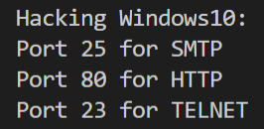
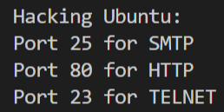
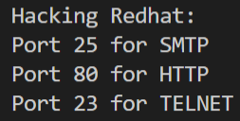
Dictionary of Dictionaries
Hack | Services
Win10 | {25: 'SMTP', 80: 'HTTP', 23: 'TELNET'},
Ubuntu | {25: 'SMTP', 80: 'HTTP', 23: 'TELNET'},
Redhat | {25: 'SMTP', 80: 'HTTP', 23: 'TELNET'},
for hack in hacklist:
print(f'Hacking {hack}: ')
for port in hacklist[hack]:
print(f'Port {port} for {hacklist[hack][port]} ')
Note: Manually formatted
Notes:
os = ['Windows10', 'Ubuntu', 'Redhat']
portlist = {25:"SMTP",80:"HTTP",23:"TELNET"}
hacklist={} #empty dictionary
for op in os:
hacklist[op]=portlist
print(hacklist)
for hack in hacklist:
print(f'Hacking {hack}: ')
for port in hacklist[hack]:
print(f'Port {port} for {hacklist[hack][port]} ')

Slide 71
Looping and Enumerating iterables

Slide 72
Enumerate
Notes:
https://www.programiz.com/python-programming/methods/built-in/enumerate
os = ['Windows10', ''Debian', 'Ubuntu', 'Redhat', 'Kali']

Slide 73
Enumerate
It allows us to loop over any Python iterable with an automatic counter (think of your conventional for loops).
Optional parameter determines start index
os = ['Windows10', 'Debian', 'Ubuntu', 'Redhat', 'Kali']
print(list(enumerate(os)))
print(list(enumerate(os,1)))
Notes:
os = ['Windows10', 'Debian', 'Ubuntu', 'Redhat', 'Kali']
print(list(enumerate(os)))
print(list(enumerate(os,1)))

Slide 74
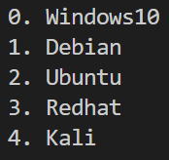
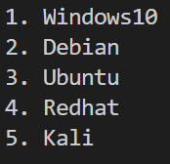
Enumerate - example
os = ['Windows10', 'Debian', 'Ubuntu', 'Redhat', 'Kali']
for i, op in enumerate(os):
print(f'{i}.{op}')
os = ['Windows10', 'Debian', 'Ubuntu', 'Redhat', 'Kali']
for i, op in enumerate(os,1):
print(f'{i}.{op}')
Notes:
os = ['Windows10', 'Debian', 'Ubuntu', 'Redhat', 'Kali']
for i, op in enumerate(os):
print(f'{i}.{op}')

Slide 75
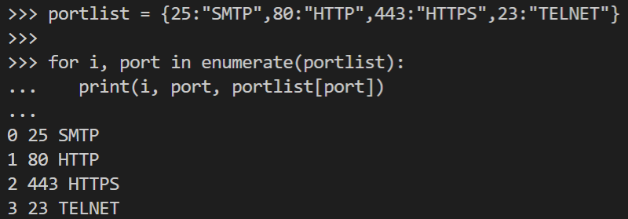
Enumerating Dictionaries
You can index the name-value pairs using enumerate()
portlist = {25:"SMTP",80:"HTTP",443:"HTTPS",23:"TELNET"}
print(list(enumerate(portlist.items())))
Port | Service
25 | SMTP
80 | HTTP
443 | HTTPS
23 | TELNET
Notes:
portlist = {25:"SMTP",80:"HTTP",443:"HTTPS",23:"TELNET"}
print(list(enumerate(portlist.items())))
for i, port in enumerate(portlist):
print(i, port, portlist[port])

Slide 76

Loop with Zip (It's NOT winzip)
Python’s zip() function is defined as zip(*iterables).
The function takes in iterables as arguments and returns an iterator. This iterator generates a series of tuples containing elements from each iterable. zip() can accept any type of iterable, such as files, lists, tuples, dictionaries, sets, and so on.
numbers = [1, 2, 3]
letters = ['a', 'b', 'c']
zipped = zip(numbers, letters)
print(list(zipped))
print(zipped) # Holds an iterator object
print(type(zipped))
Notes:
Ref: https://realpython.com/python-zip-function/
Python’s zip() function is defined as zip(*iterables). The function takes in iterables as arguments and returns an iterator. This iterator generates a series of tuples containing elements from each iterable.
zip() can accept any type of iterable, such as files, lists, tuples, dictionaries, sets, and so on.

Slide 77


Loop with Zip
When you’re working with the Python zip() function, it’s important to pay attention to the length of your iterables. If the lengths are different, the number of elements that zip() puts out will be equal to the length of the shortest iterable. The remaining elements in any longer iterables will be totally ignored by zip(), as you can see here:
print(list(zip(range(5), range(100)))) # output = [(0, 0), (1, 1), (2, 2), (3, 3), (4, 4)]
In Python 3, zip() returns an iterator. This object yields tuples on demand and can be traversed only once.
x = zip(range(5), range(100))
print(tuple(x))
print(tuple(x))
x = list(zip(range(5),range(100)))
print(x)
print(x)
Notes:
x = zip(range(5), range(100))
print(tuple(x))
print(tuple(x))
x = list(zip(range(5),range(100)))
print(x)
print(x)

Slide 78

Loop with Zip
No unzip() function in Python. Use zip() along with the unpacking operator *
numbers = (1, 2, 3, 4)
letters = ('a', 'b', 'c', 'd')
num_ltr = tuple(zip(numbers,letters))
print(num_ltr)
# unzipped
num, ltr = zip(*num_ltr)
print(num)
print(ltr)
Notes:
numbers = (1, 2, 3, 4)
letters = ('a', 'b', 'c', 'd')
num_ltr = tuple(zip(numbers,letters))
print(num_ltr)
# unzipped
num, ltr = zip(*num_ltr)
print(num)
print(ltr)

Slide 79
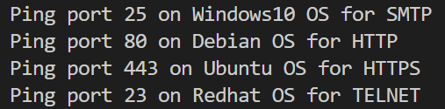
Loop with Zip
Zip function is convenient if you need to loop through multiple iterables together.
os = ['Windows10', 'Debian', 'Ubuntu', 'Redhat']
portlist = {25:"SMTP",80:"HTTP",443:"HTTPS",23:"TELNET"}
print(list(zip(os,portlist))) # zip the key only
Notes:
os = ['Windows10', 'Debian', 'Ubuntu', 'Redhat']
portlist = {25:"SMTP",80:"HTTP",443:"HTTPS",23:"TELNET"}
print(list(zip(os,portlist))) # zip the key only
for op, port in zip(os,portlist):
print(f'Ping port {port} on {op} OS for {portlist[port]}’)

Slide 80
Loop with Zip
For Dict: only zip the key
os = {'WIN':'Windows10', 'DEB':'Debian', 'UBT':'Ubuntu', 'RED':'Redhat'}
portlist = {25:"SMTP",80:"HTTP",443:"HTTPS",23:"TELNET"}
x = (list(zip(os,portlist)))
print(x)
Notes:
For Dict: only zip the key
os = {'WIN':'Windows10', 'DEB':'Debian', 'UBT':'Ubuntu', 'RED':'Redhat'}
portlist = {25:"SMTP",80:"HTTP",443:"HTTPS",23:"TELNET"}
x = (list(zip(os,portlist)))
print(x)

Slide 81
Practice – Dictionary / Enumerate
P03
Notes:
Prac2-Q1 to Q3

Slide 82
Python Files

Slide 83
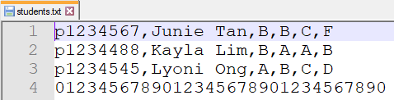

Accessing files
Aside getting inputs from the keyboard, we can also read inputs from files
To read a file, use the open() function which returns a file object
Indicate any folders before the filename
This function returns a file object, and is most commonly used with two arguments: open(filename, mode)
Mode is optional and can be r (read) or w (write) or a (append).
# specify the FULL pathname
fn=open('./students.txt','r') # default is read mode
contents = fn.read() # read entire file
print(contents)
fn.close() # must close the file

Slide 84


Reading files
File object functions - read() # reads and return ALL content
fn=open('./students.txt', 'r') # read mode
contents = fn.read() # read entire file
print(type(contents))
print(contents[0:30]) # from subscript 0-29
print(f'Non printable char (newline): **{contents[26]}**')
fn.close() # must remember to close the file
Char No. 26 = newline = CRLF
Notes:
List = array in Javascript

Slide 85
Reading files
File object functions - readlines() # reads all, return list
fn=open('./students.txt','r')
contents = fn.readlines() # reads all into list
print(type(contents))
print(contents)
print(contents[1])
fn.close() # must remember to close the file
No newline
Returns list of strings. At End of File, returns empty string ‘’
Notice the newline at the end of the string
contents[1])
No newline. Check the source input file.

Slide 86

Reading files
File object functions - readline() # reads one line
fn=open('./students.txt', 'r')# read mode
line = f.readline() # read one line
print(type(line))
print(line)
fn.close() # must remember to close the file

Slide 87
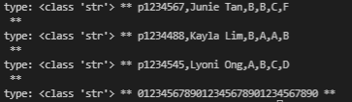
Reading files – line by line
File object functions - readline() # reads one line
fn=open('./students.txt','r') # read mode
for line in fn: # read one line
print(f'type: {type(line)} ** {line} **')
fn.close()

Slide 88
Writing files – line by line
File object functions - readline() # reads one line
fn_out=open('./students.out','w') # write mode
fn=open('./students.txt','r') # read mode
for line in fn: # read one line
print(f'type: {type(line)} ** {line} **')
fn_out.write(line)
fn.close()
fn_out.close()

Slide 89
Reading files – line by line
File object functions - readline() # reads one line
with open('./students.txt','r') as fn:
for line in fn: # read one line
print(f'type: {type(line)} ** {line} **')
The with statement creates a context manager and it will automatically close the file handler for you when you are done with it..
How to remove the newline character at the end of each string?

Slide 90

Reading files – line by line
File object functions - readline() # reads one line
with open('./students.txt','r') as fn:
for line in fn: # read one line
print(f'type: {type(line)} ** {line}.strip() **')
The with statement creates a context manager and it will automatically close the file handler for you when you are done with it..

Slide 91
Reading/Writing files – line by line
File object functions - readline() # reads one line
with open('./students.txt','r') as fn:
contents = fn.readlines() # reads all into list
print(contents)
with open('./students-out.txt','w') as fn:
fn.write(str(contents))
We shall leave you to explore opening the file for append on your own.

Slide 92
Practice – File Handling
P03
Notes:
Prac2-Q1 to Q3

Slide 93
Summary
Review your learning:
Strings
Lists
Tuples and Sets
Dictionary
Looping and Enumerating iterables
File Handling

